Slide 1
E-learning Course For Kids 4-12 Years
Course Name: How To Ride A Bicycle
Audience: Elementary School Students Age 4-12
Course Goal: Promote A Culture Of Bike Riding For Increased Physical Activity Among Children.

Slide 2
Course Objectives
Finding the right bike
Riding safely
Taking off
Riding on slopes
Braking
Steering

Slide 3
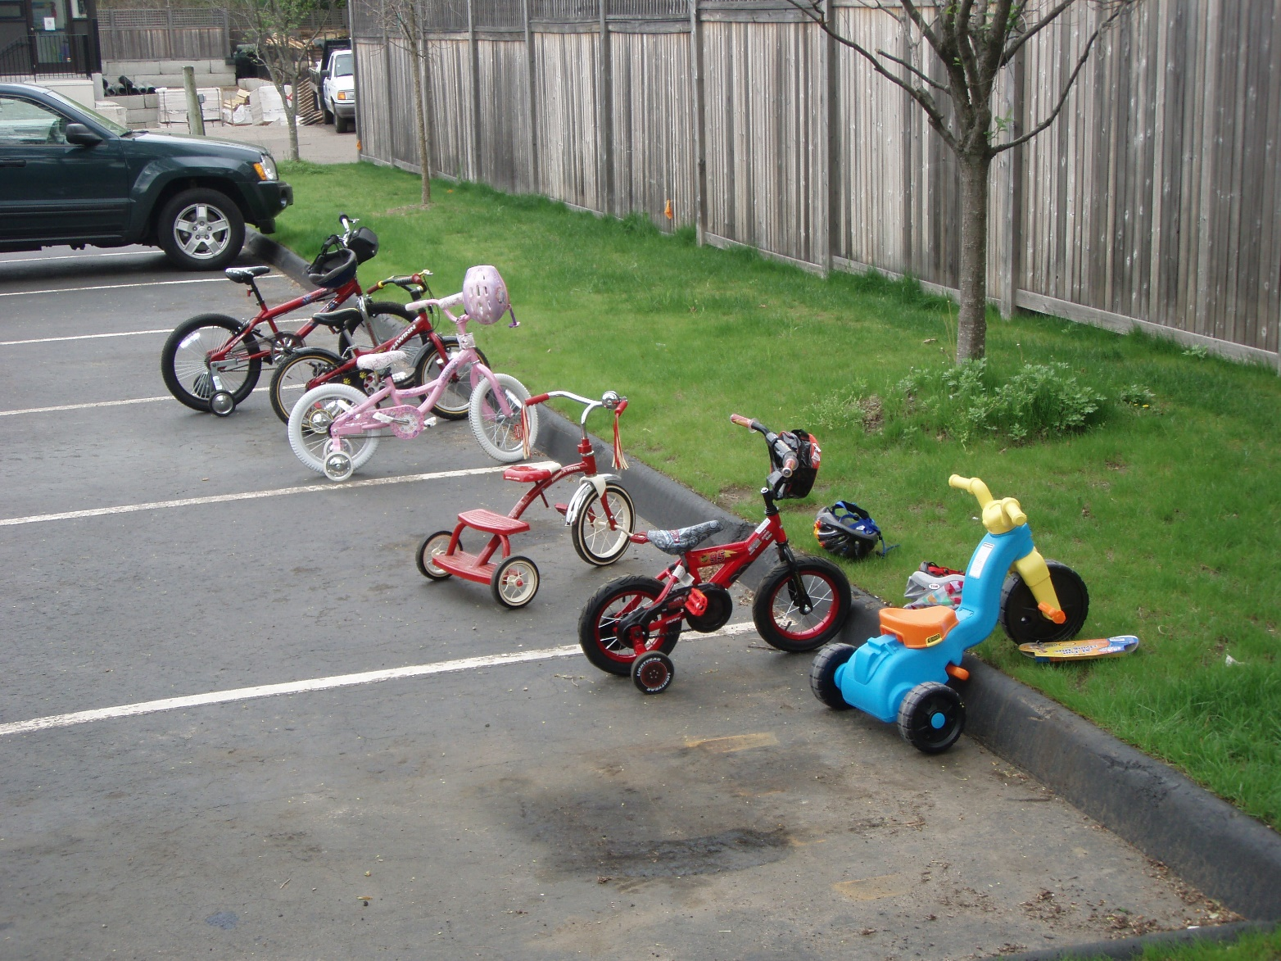
Finding The Right Bike
To begin learning, you must choose the most appropriate bike to ride.
The choice of the bike should not be influenced by the color nor the model.
Check if the tires rotate smoothly and braking.
A heavier and studier bike is preferable as it helps maintain flow, balance and rhythm.
Notes:
The bike that you chose must be of your size.
One of Your feet must be able to reach the ground as the other is on one pedal while sitting on the seat before taking off.
It is recommended that the wheel dimeter that is bike size should rage between 12 and 24 inches for children aged between 4 and 12 years.
For one to find the right bike, we shall use the kids Bike size Calculator hence every child must be sure of their real age.

Slide 4
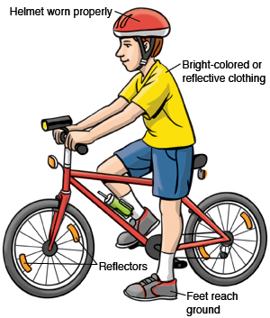
Riding Safely
Before beginning to ride, ensure that you have worn your Helmet properly to prevent you from injuries incase of accident.
Where a reflective clothing for other motorist on the road to easily identify you.
Where light sport shoes to avoid fatigue caused by cycling with heavy shoes.
Also carry some water to keep you hydrated.
Notes:
You need to be safe while riding your bike.
Remember you will not be alone riding , there will be other motorist on the way hence anything such as an accident can occur on the way.
To be more safe, before starting riding your bike, remove the pedals and lower the seat which will allow you to sit upright with your legs straight and your feet flat on the ground.
You need also to properly inflate your bike tires (Lehtonen, et al., 2017).
Your trainer will hold the seat until the bike gets moving then you will be expected to balance the bike as trained.

Slide 5
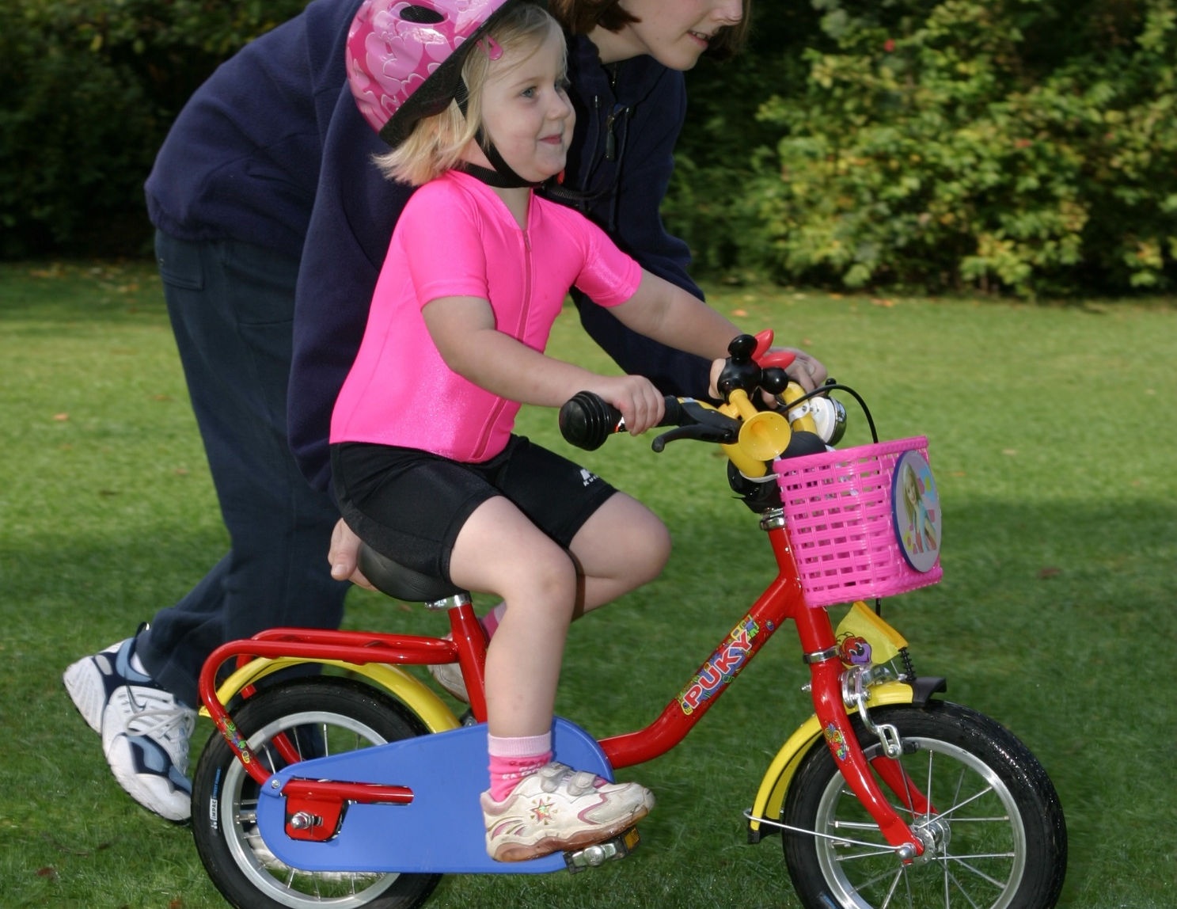
Riding Safely
For the training, we shall use grassy field to minimize the extent of injury in case of falls.
The field will be using will not be used for any other purpose during the entire training hours.
Notes:
Training to ride in a place with no distractions will enable you to learn riding faster.
As we begin the training, you are all requested to ride in the same direction with others (Go with the traffic flow).
You need also to be predictable and stay alert all the time. From time to time your trainer will provide different tests to you hence alertness is important (Toovey, et al., 2017).
You are also requested to always look twice before turning and watch your partners especially when they park.

Slide 6
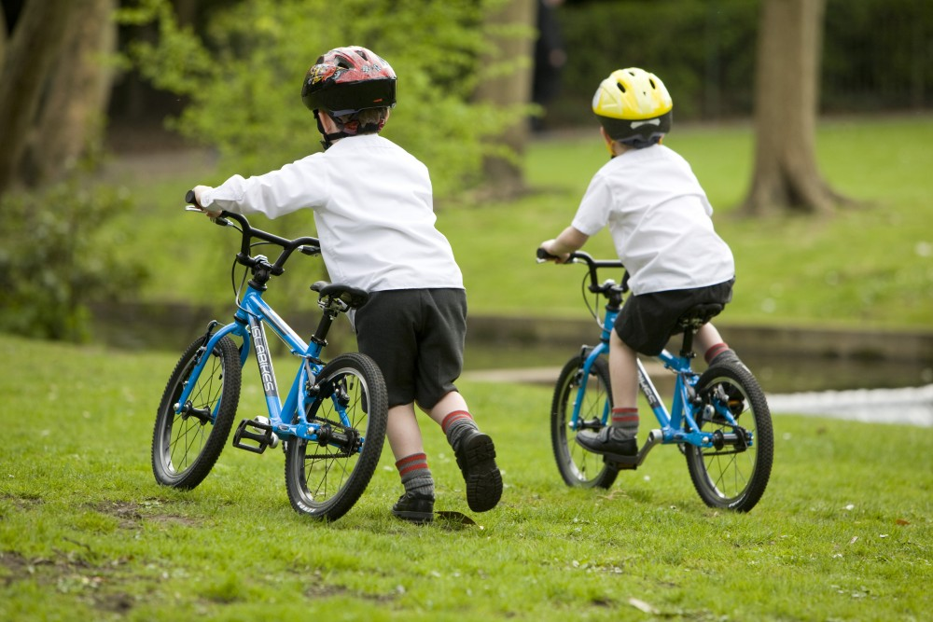
Taking Off
You will take off from a flat location that is covered with glass.
You will begin on flat surface such as a driveway, park trail or sidewalks as they are more stable and help in pedaling harder.
You will also Lower the seat and put feet loser on the ground which will help you stop from falling.
Specialty balance bikes are helpful here. Start pushing with one foot and try to balance as much as possible while in motion
Notes:
Anytime you feel the bike tipping, put one foot on the ground and push off again.
The match time and hard work you will give it will determining how fast you will learn to take off.
If you will practice for two days daily, you will learn how to precisely take off and ride the bike in 3 to 4 days.
As you learn to take off, focus on maintaining a good position on the bike, save your strength, let your legs do the work, feed the fire inside, look where you want to go and ride with the pack (Toovey, et al., 2017).

Slide 7
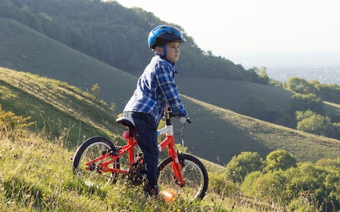
Riding on slopes
  After learning to take off, you will need to ride on slopes to enhance your balancing skills.
  From the top of the slope, mount the bike and glide down naturally for a number of times to ensure balance.
  As you take off, Keep your body relaxed, elbows bent with the body well pressed against the seat.
Notes:
Since it is the first time to cycle a bike, the smooth slope will be more efficient and will allow you to gain speed without much efforts in cycling.
You will just have to put all your concentration on balancing your bike.
Your trainer will hold the bike at the top of the grassy slope then you will be required to straddle the seat and put both feet on the ground (Lehtonen, et al., 2017).
Your trainer will hold the seat until the bike gets moving then you will be expected to balance the bike as trained.

Slide 8
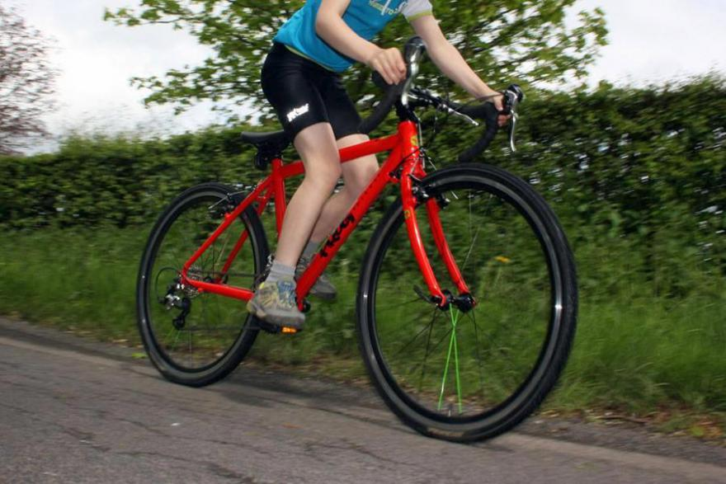
Braking
For breaking skills enhancement, you are required to ride towards a gentle slope
Once there is more comfort with the feet on the pedal try squeezing the brakes gently while gliding down the slope.
Do not break instantly to avoid losing control.
Notes:
Braking gently ensures you do not swerve out of control.
All your bikes will have hands brakes. You can brake while your feet are on the pedals or off.
In cases when you want to turn and do not want to stop, you need to apply less for on the brakes, then after the bike slows down.
Gently turn and move the direction you needed (Halayko, et al., 2016).
If you want to stop suddenly especially when you encounter a barriers on the way, you will have to squeeze the brake levers on the handlebars.

Slide 9
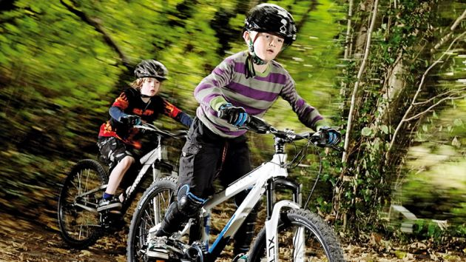
Steering
A gentle slope ground will perfectly train you on how to effectively steer.
With mastery of coasting, pedaling and braking, try moving the handlebars until you change direction without losing control
Steering on a slope helps you feel how the way the bike adjusts and acts to match the slope.
Notes:
A Gentle slope ground will train you on how to balance between steering and braking.
As you learn how to ride, you are expected to have your hands as flexible as possible.
Most of the times you will encounter different obstacles on your way as you are riding hence, you are supposed to rotate the steering handle to a certain angle to avoid the obstacles then proceed on riding.
During the entire training you are not supposed to ride on one hand at all (Dunford, Bannigan, & Rathmell, 2016).

Slide 10
References
Dunford, C., Bannigan, K., & Rathmell, S. (2016). Learning to ride a bike: developing a therapeutic intervention. CYPF Journal, 20, 10-18.
Halayko, J., Magill-Evans, J., Smith, V., & Polatajko, H. (2016). Enabling 2-wheeled cycling for youth with Down Syndrome. Pediatric physical therapy, 28(2), 224-230.
Lehtonen, E., Sahlberg, H., Rovamo, E., & Summala, H. (2017). Learning game for training child bicyclists’ situation awareness. Accident Analysis & Prevention, 105, 72-83.
Toovey, R., Reid, S. M., Rawicki, B., Harvey, A. R., & Watt, K. (2017). Ability of independently ambulant children with cerebral palsy to ride a two‐wheel bicycle: a case–control study. Developmental Medicine & Child Neurology, 59(4), 395-401.

